Slide 1
Annual Impact and Outcome Report
2022 - 2023
Communities In Schools of Brunswick County, Inc.

Slide 2
Action for Success Program
The CIS Action for Success Program provides Success Coaches who work as time embedded team members at assigned school sites for the school year.
They work to provide school wide supports, and case management and targeted interventions for individual students with moderate to high intensity needs.
Interventions are provided one-on-one and in small groups and include tutoring, mentoring, social-emotional learning, behavior interventions, attendance interventions, linkage with community resources, and basic needs.

Slide 3
Action for Success Program
The CIS Action for Success Program serves 4 elementary and 5 middle schools in the Brunswick County Schools district.
CIS has worked in partnership with Brunswick County Schools for the past 28 years.
The primary focus of the Action for Success Program is dropout prevention.
Interventions used with students are research or evidence based and all services are provided through individualized Student Support Plans developed for each student based on his or her unique needs.
Progress is monitored and services are adjusted throughout the school year based on the student’s progress.

Slide 4
School Collaborations
CIS Success Coaches work as integrated members of their school community. One way they do this is by serving on school-based teams and committees that work to improve school climate, promote collaboration, and strengthen student intervention and support.
School Improvement Team
PBIS Committee – Positive Behavior Intervention and Supports
Attendance Committee
MTSS Committee – Multi-Tiered System of Supports
Student Support Committee
You Matter
Testing Team

Slide 5
Tier I School Wide Services
Total Students Served: 4,275
Birthday in a Box PBIS Rewards
Basic Needs – Clothing, Hygiene products Journalism Club
Kindness Week – Character Trait Lessons Life/Social Skills Lessons
Why Try Lesson Series in 21st Century Afterschool Program Social Emotional Classroom Lessons
Attendance Committee and Student Attendance Incentives School Supplies
In School Suspension Program – Character Development Mentoring
Classroom Behavior Modification Bullying and Violence Prevention
Academic Assistance Brick by Brick Club
Game Changers Club Lunch Bunch groups
Builders Club PBIS Chess Club
Bow Tie Club

Slide 6
Individually Case Managed Students
Total Case Managed Students: 541
Attendance: Behavior:
101 students 96 Students
76% met goal or made progress 78% met goal or made progress
Coursework: Social Emotional Learning:
331 students 123 Students
81% met goal or made progress 90% met goal or made progress

Slide 7
Middle School Team
Leland Middle
Town Creek Middle
South Brunswick Middle
Cedar Grove Middle
Shallotte Middle

Slide 8
Team Members and Schools
Calie Capps Hodgson, Lead Success Coach - Town Creek Middle
Ruth Thompson, Success Coach – Leland Middle
Melodie Herbein, Success Coach – Leland Middle
Bryan Mills, Success Coach – South Brunswick Middle
Taylor Watkins, Success Coach – Cedar Grove Middle
Olivia Hintz, Success Coach – Shallotte Middle

Slide 9
Middle School Demographics
Percentage of Economically Disadvantaged Students by School:
Cedar Grove Middle – 63.6%
Shallotte Middle – 58.9%
Leland Middle – 50.1%
South Brunswick Middle – 38.6%
Town Creek Middle – 42.2%
While poverty alone is not an indicator that a student will struggle in school, it is a significant factor and one which can place students at both social and academic disadvantage in comparison to their peers from higher income households.

Slide 10
Snapshot: Leland Middle
768 Students “D” School Rating Title I School
Targeted Support and Improvement (TSI), TSI CU (Consistently Underperforming Subgroups), and NC Designated Low Performing School and Recurring Low Performing School
39.8% Math End of Grade Proficiency
39.0% Reading End of Grade Proficiency
38.74% Chronic Absenteeism Rate

Slide 11
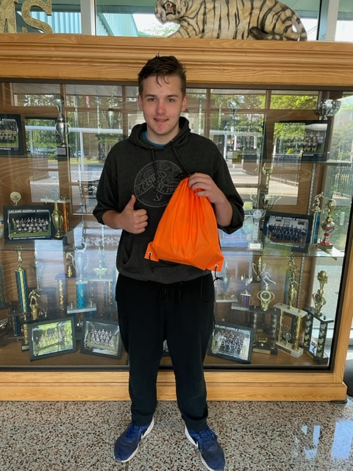
Leland Middle Tier I School Wide Support Highlight
"Super Student"
Teachers send names all year of students who are doing their best in school, who are responsible, helpful, dependable, etc. Every Friday Mrs. Thompson randomly picks a name, and that student wins a prize bag. Also, their photo is posted on the school Facebook page. Prizes are provided mostly by the Kiwanis Club. There are a few other contributors, like Farm Bureau.

Slide 12
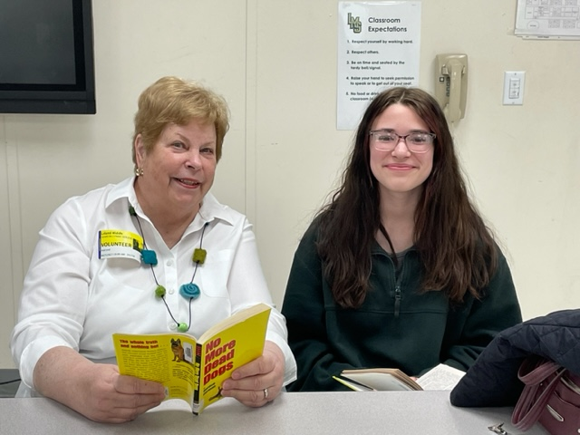
Leland Middle Success Story: Charity Waite

Slide 13
Charity’s Story:
Charity was referred to Action for Success last year in 6th grade. She was referred for Reading and Behavior. Success Coach Mrs. Thompson put Charity into Reading tutoring last year in 6th grade with Mrs. Herzog, a volunteer tutor, in a group of two students. She did pretty well but wasn’t as engaged and motivated as she could have been. Most of the time Mrs. Thompson had to remind her to attend tutoring, and then sometimes she would still “forget”. She continued with the same tutor this year for Reading tutoring, but this time, one-on-one. The tutor says that this year “her overall demeanor has improved. She is more outgoing, more collaborative, and more positive.” And most of the time she comes to tutoring on her own. Her grade last year in English Language Arts was failing and this year she has an A. Mrs. Thompson monitored Charity’s behavior and talked with her about strategies to do better. Last year she had 2 Disciplinary Referrals and this year she has had none. This year she has been on Ms. Herbein’s caseload (Ms. Herbein is the second Success Coach working at Leland Middle). Ms. Herbein says that “Charity is a truly special person. She is someone that is always a pleasure to work with and speak to. All of her teachers and tutors have noted what an incredible young woman she is growing into. Charity has become very involved in the school as well, joining the chorus and the drama club this year. We believe great things lie ahead for her and we can wait to see what all she can accomplish.” Charity has also participated in Lunch Bunch this year with Mrs. Herbein. Charity says that “Mrs. Herzog, Mrs. Herbein, and Mrs. Thompson have taught me how to be more positive and have encouraged me to be more engaging. I have also surrounded myself with positive friends who are a good influence. Mrs. Herbein has taught me to be more social, helping me to talk to others. Tutoring has helped me raise my ELA grade. If CIS was not here, I would be failing.” Charity moved at the end of this year and Ms. Herzog did not think that she would be able to see her again. There were tears in her eyes when she didn’t think she would be able to tell her good-bye. However, she was able to.

Slide 14
Snapshot: South Brunswick Middle
631 Students “C” School Rating Title I School
Targeted Support and Improvement (TSI), TSI CU (Consistently Underperforming Subgroups)
52.1% Math End of Grade Proficiency
51.3% Reading End of Grade Proficiency
38.07% Chronic Absenteeism Rate

Slide 15
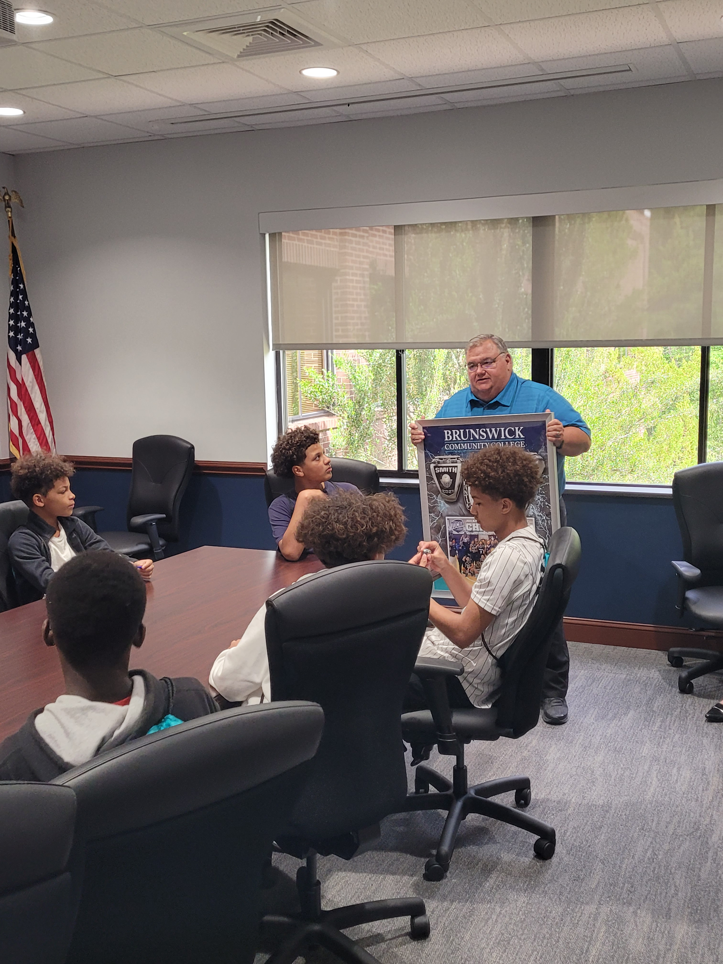
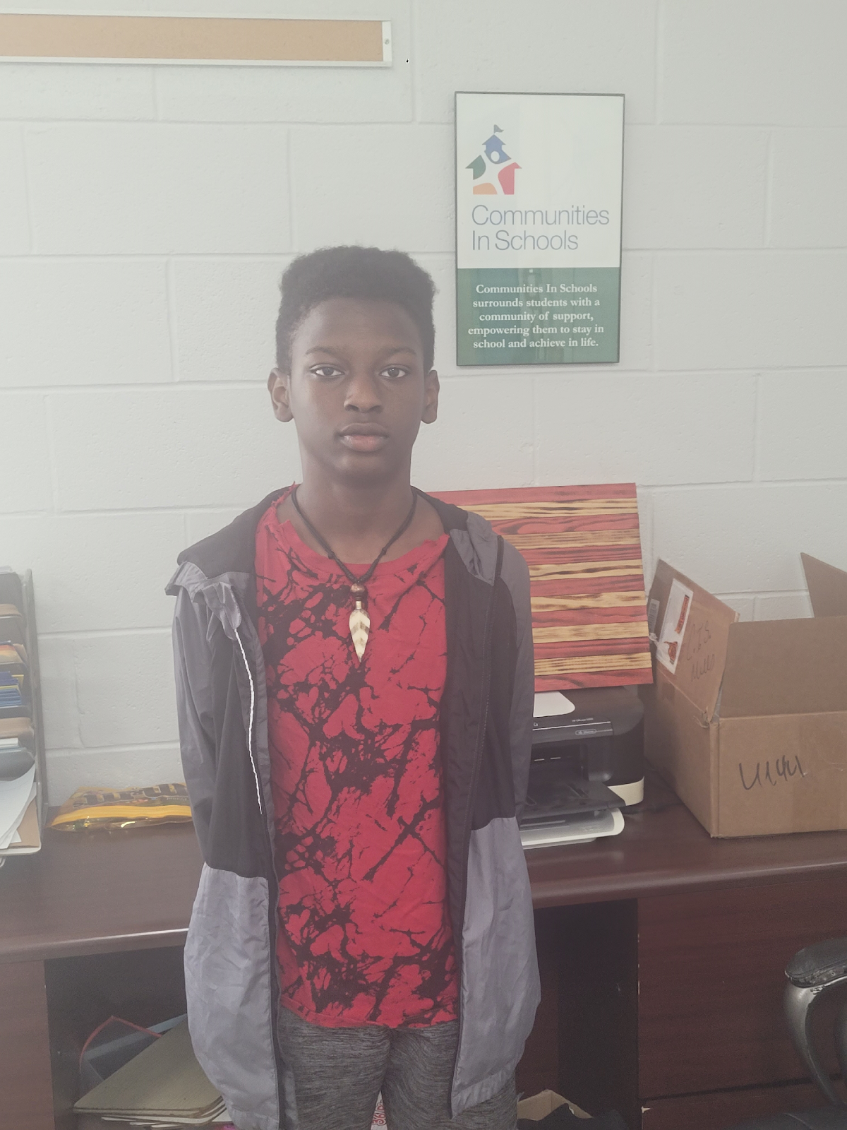
South Brunswick Middle Tier I School Wide Support Highlight
“Game Changers Club”
Feedback from Christopher Jones
I thought that being able to see a successful black person teach and mentor us was cool. I also thought being able to see different college facilities was nice. I think learning things and other tips was very helpful for our lives.

Slide 16
South Brunswick Middle Tier I School Wide Support Highlight
Game Changers’ vision and goal is to impact students positively so they can succeed academically and socially. As we focused in this past year we wanted to spotlight self-confidence, improve communication skills and goal setting.
Deputy Willie McRae, our community mentor, wanted to instill self-confidence by offering guidance, reassurance, and a listening ear to our students. Often times he would listen as the young people shared their experiences. Deputy McRae helped students navigate challenges and uncertainties, instilling confidence in their abilities to overcome obstacles.
Effective communication is a cornerstone to success in all aspects of life. Game Changers worked with students in speaking to adults. Students were also mentored on how to dress and groom themselves for different situations and events. For example, students were taught how to dress for a job versus hanging out with their friends.
Setting and achieving goals is a crucial skill for young people. Our program worked to provide our students with a sense of purpose and direction. We encouraged students to have a vision of what they wanted to be when they graduated, and we would check in with them, providing accountability by asking if their actions are actions that would lead them to their goals.

Slide 17
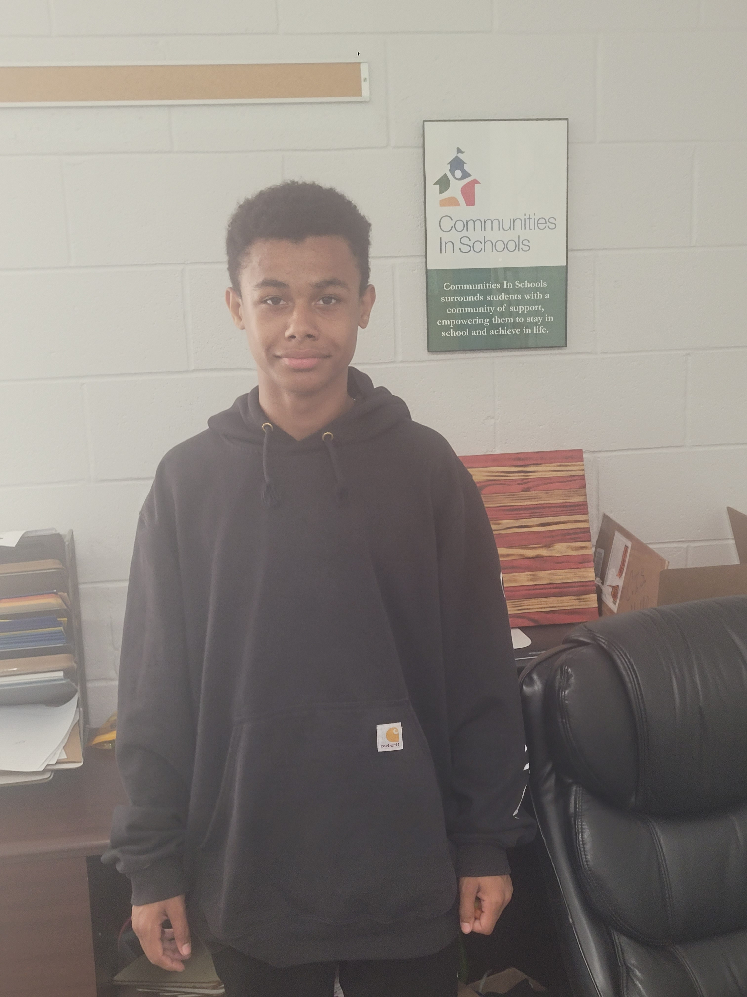
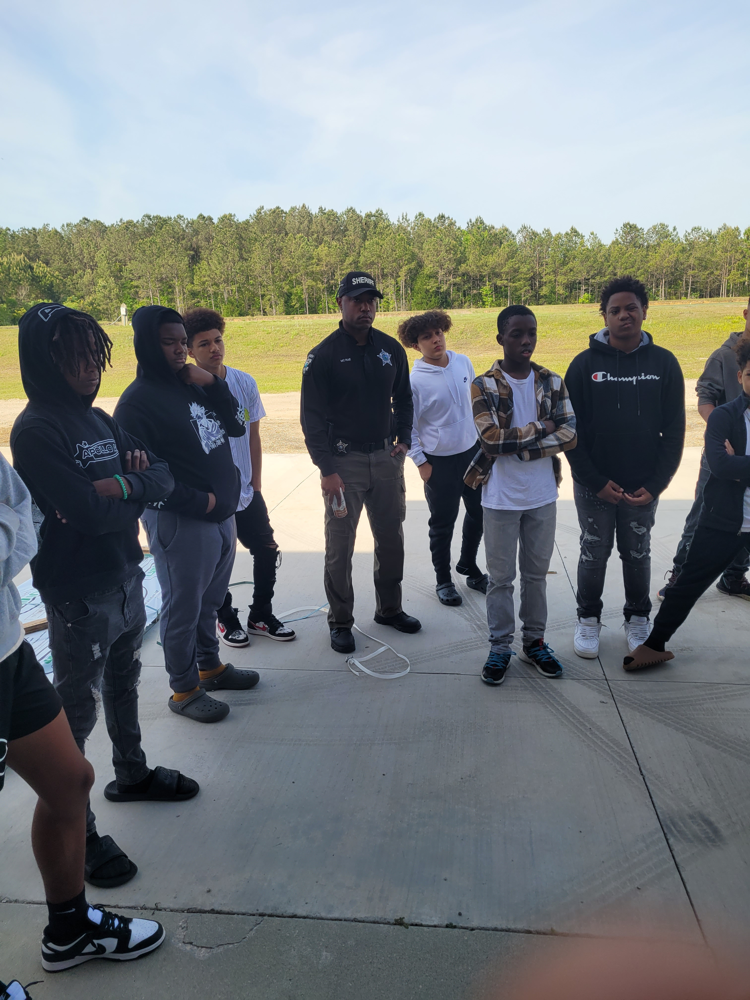
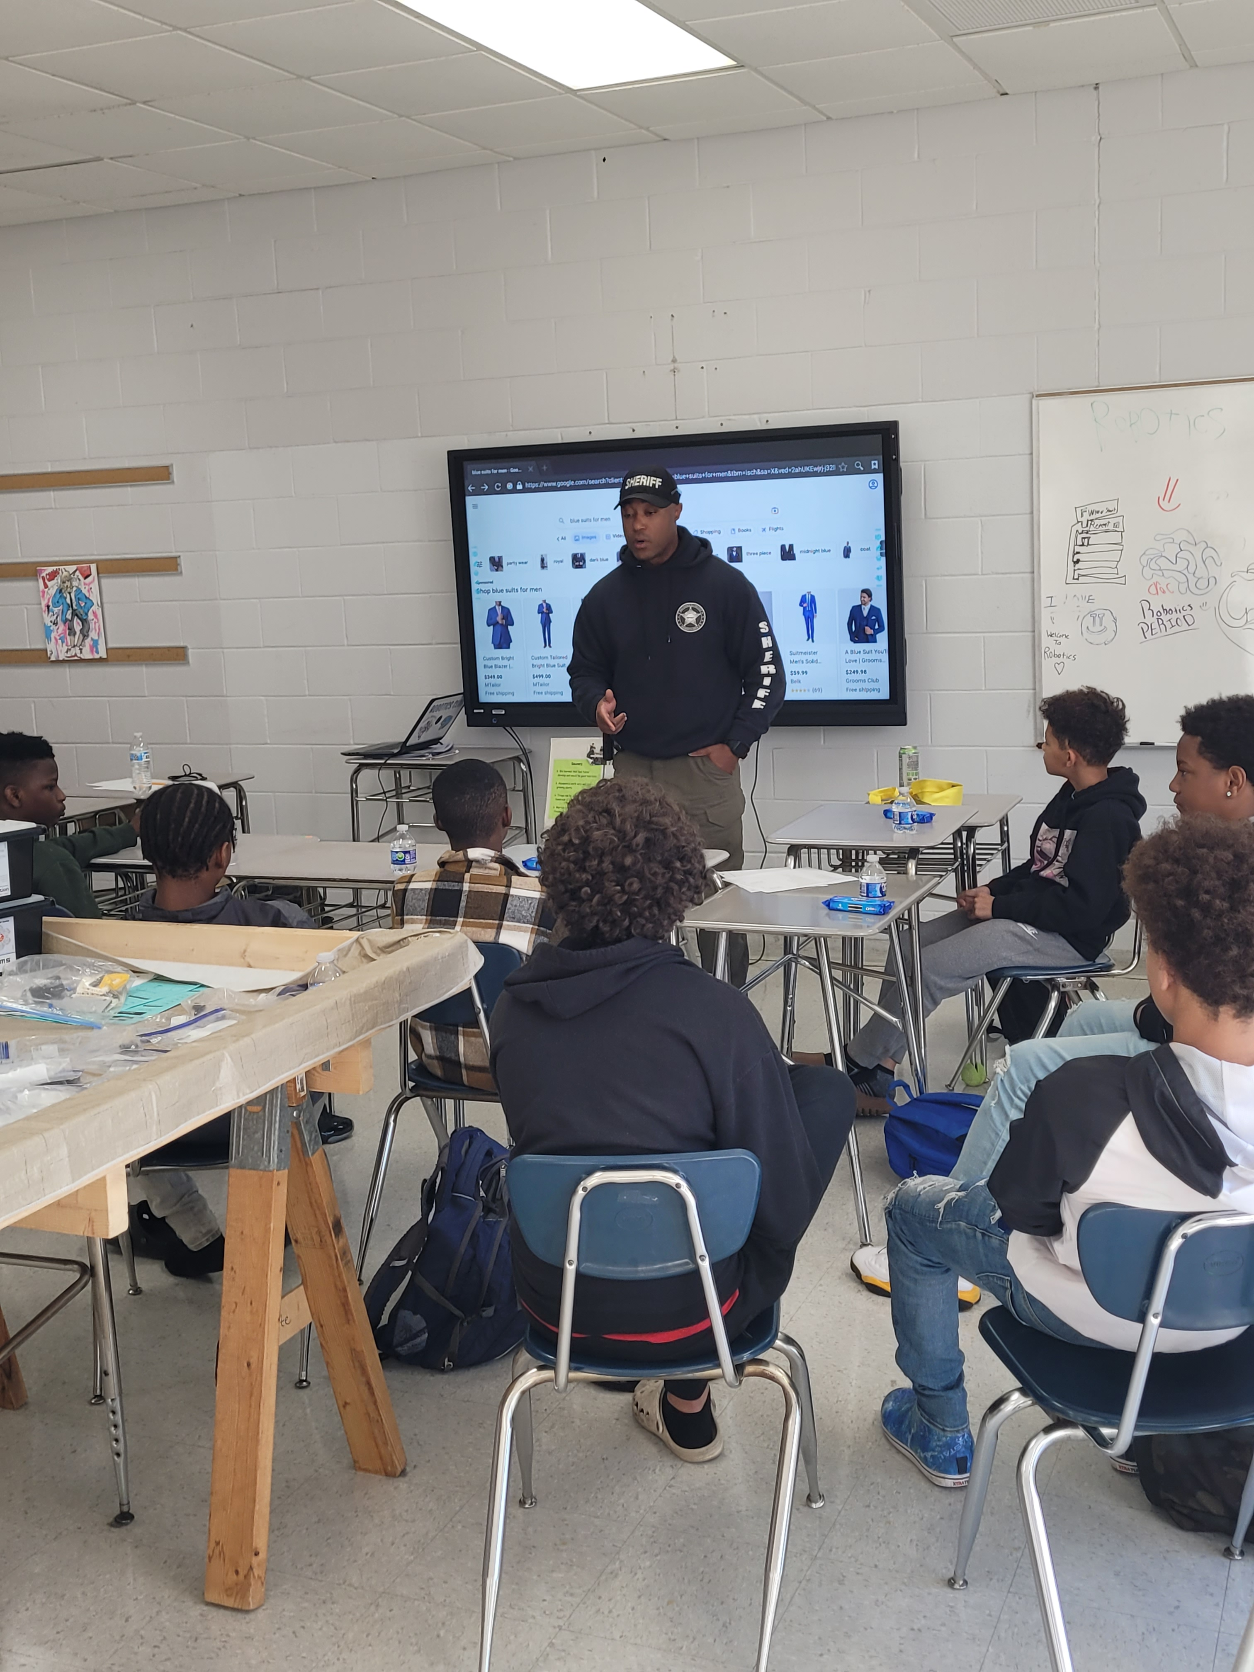
South Brunswick Middle Success Story: Xzander Lance

Slide 18
Xzander’s Story:
A success story for the past school year is the creation of the Game Changers and working with students to help them discover a life vision. Often times students are not successful because they do not have a vision or cannot see themselves being successful. Working with these young students and helping them realize how to succeed and achieve has been a real pleasure.
Xzander shared, “My experience with Game Changers was fun. I liked all the activities we did. We learned how to tie a tie. We went to Brunswick Community College and saw all the classes we can take. Deputy McRae is funny. He told us not to do dumb things and get our schoolwork done. He wants us to be successful.”
Another participant, Chris Jones, shared, “I thought that being able to see a successful black person teach and mentor us was cool. I also thought being able to see different college facilities was nice. I think learning things and other tips was very helpful for our lives.”
Game Changers is led by Success Coach Bryan Mills and Sheriff’s Deputy McRae. Together they are having a positive impact on the lives of young male students at South Brunswick Middle School. The Sheriff’s Department has indicated they would like to replicate this club at other schools as well in the coming year.

Slide 19
Snapshot: Cedar Grove Middle
462 Students “C” School Rating Title I School
Targeted Support and Improvement (TSI), TSI CU (Consistently Underperforming Subgroups)
48.9% Math End of Grade Proficiency
40.8% Reading End of Grade Proficiency
41.15% Chronic Absenteeism Rate

Slide 20
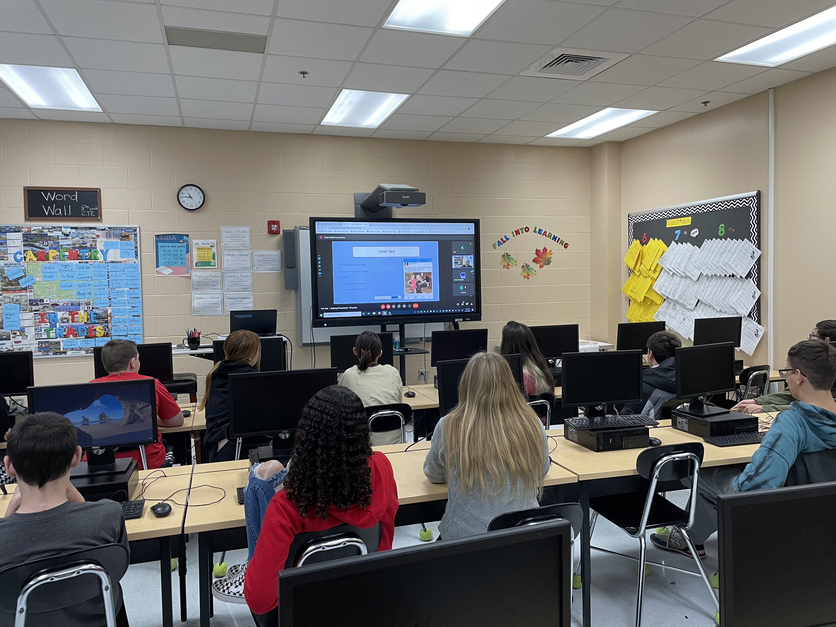
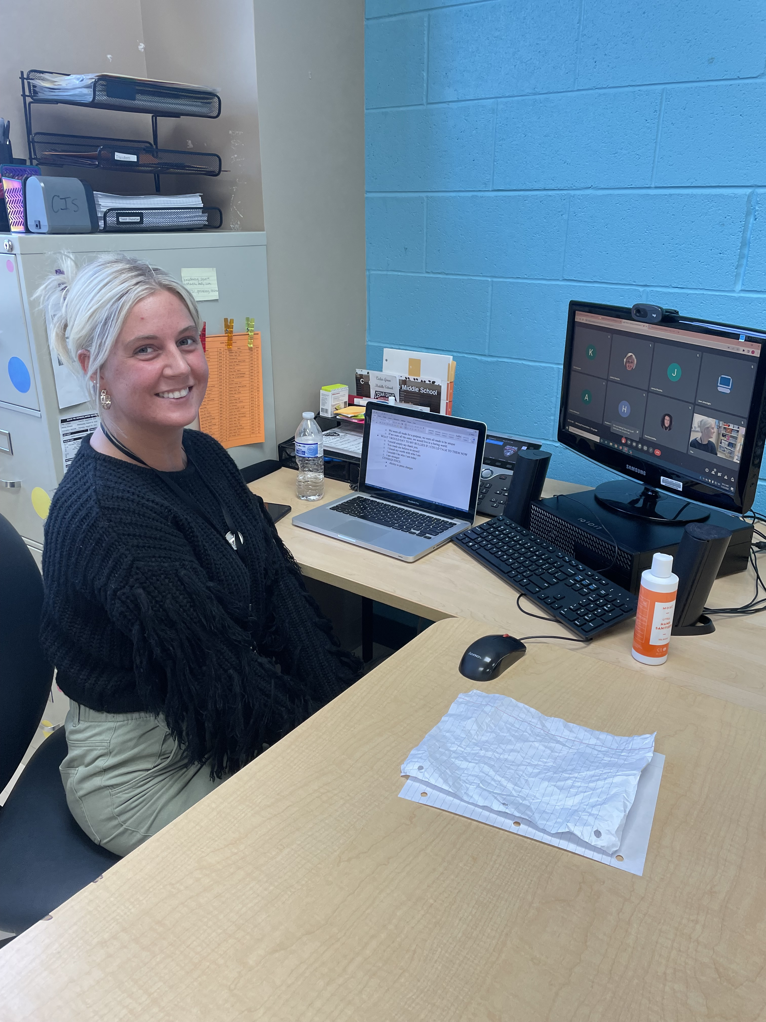
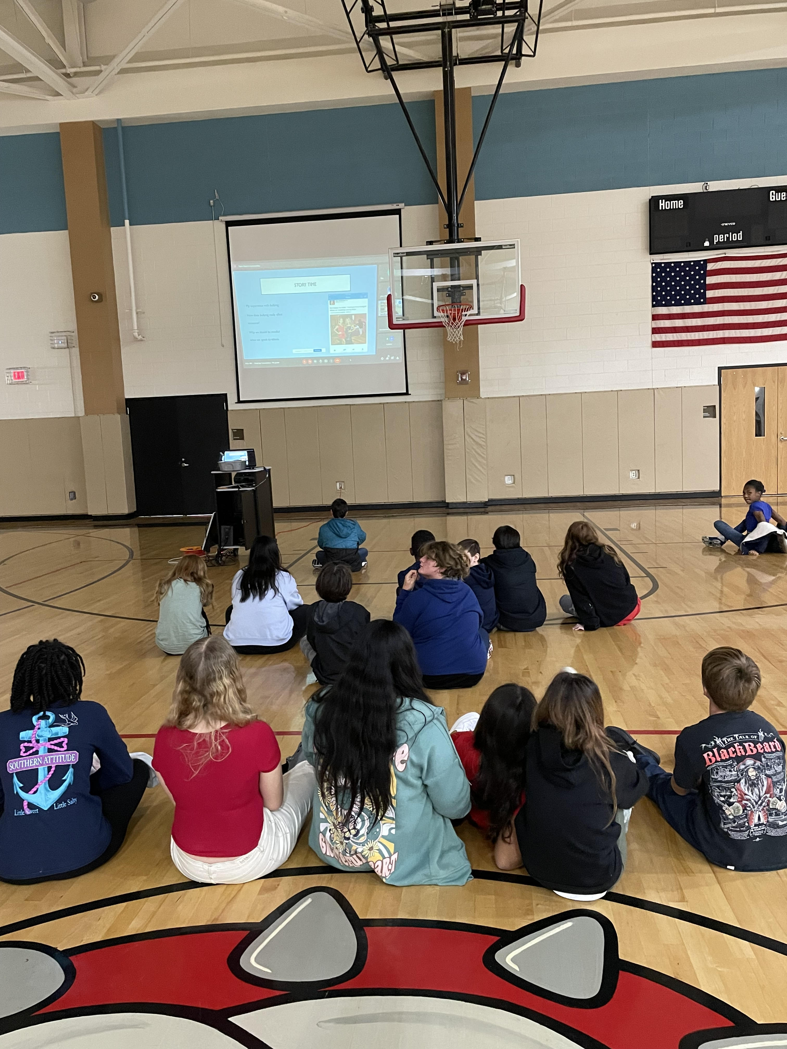
Cedar Grove Middle Tier I School Wide Support Highlight
“Bullying Awareness”
Our UNCW CIS intern Isabella Gaines provided a Bullying Presentation during Bullying Awareness week. Classes joined in virtually for Isabella's presentation and were provided time at the end to discuss the material and ask her questions. Isabella's message has been featured in several news and media outlets, so it was very neat to have it shared at Cedar Grove Middle School. This activity created a good foundation of rapport for Isabella with our students which was helpful moving forward.

Slide 21
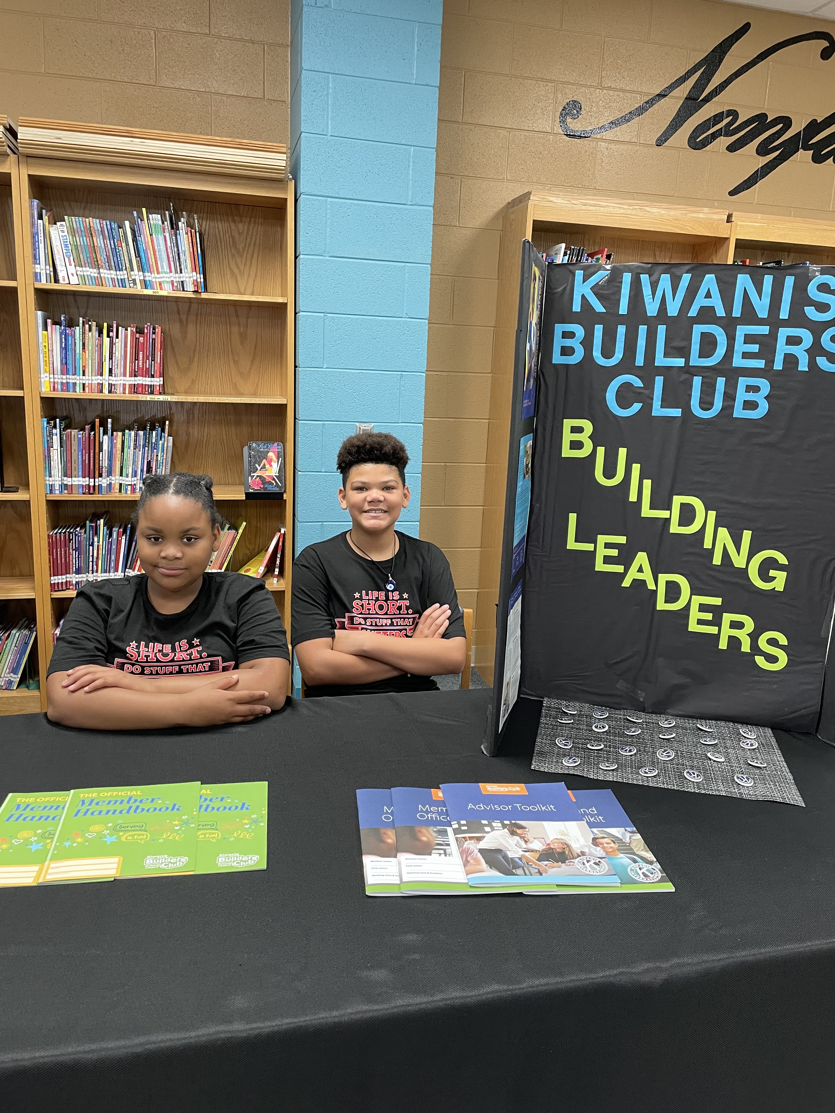
Cedar Grove Middle Success Story: Tyler Pritchett

Slide 22
Tyler’s Story:
Tyler Pritchett was referred to CIS at Cedar Grove Middle School after participating in CIS at Supply Elementary School for academic support. Over the course of the 2022/2023 School Year, Tyler met with the Cedar Grove Success Coach for tutoring and met with the CIS part-time tutor. Through these supports and Tyler’s hard work, Tyler’s fourth quarter English Language Arts (ELA) grade was 23 points higher than his grade in the first quarter! Tyler’s final ELA score was eleven points higher than his performance baseline prior to receiving CIS services!
During his 6th grade year, Tyler also developed wonderful leadership skills through his participation in Builders Club. Builders Club is a leadership club focused on service projects facilitated by the Success Coach. While working with Ms. Taylor in Builders Club, Tyler became a recruiter for the club by inviting his peers to help in
projects when he felt like the club needed help. Tyler volunteered to represent Builders Club for the elementary school walkthroughs (pictured below) and earned a club position as Treasurer. Tyler was often unafraid to put himself out there and try his best.
When Ms. Taylor held restorative circles for conflict resolution for 6th graders, Tyler would often participate. He would advocate for himself and others to work through issues and come to a resolution. During these circles Tyler would take the lead as great example on how to be both honest and kind. Tyler’s growth during 6th grade can be seen through his academic achievements, as well as his social achievements as he became a leader both in Builders Club and in the classroom. Tyler’s Success Coach looks forward to working with Tyler again next school year and helping Tyler achieve his amazing potential.

Slide 23
Snapshot: Town Creek Middle
386 Students “D” School Rating Title I School
NC Designated Low Performing School
41.0% Math End of Grade Proficiency
46.0% Reading End of Grade Proficiency
31.29% Chronic Absenteeism Rate

Slide 24
Snapshot: Shallotte Middle
674 Students “D” School Rating Title I School
TSI (Targeted Support and Improvement), TSI CU (Consistently Underperforming Subgroups), and NC Designated Low Performing School
45.9% Math End of Grade Proficiency
43.1% Reading End of Grade Proficiency
22.61% Chronic Absenteeism Rate

Slide 25
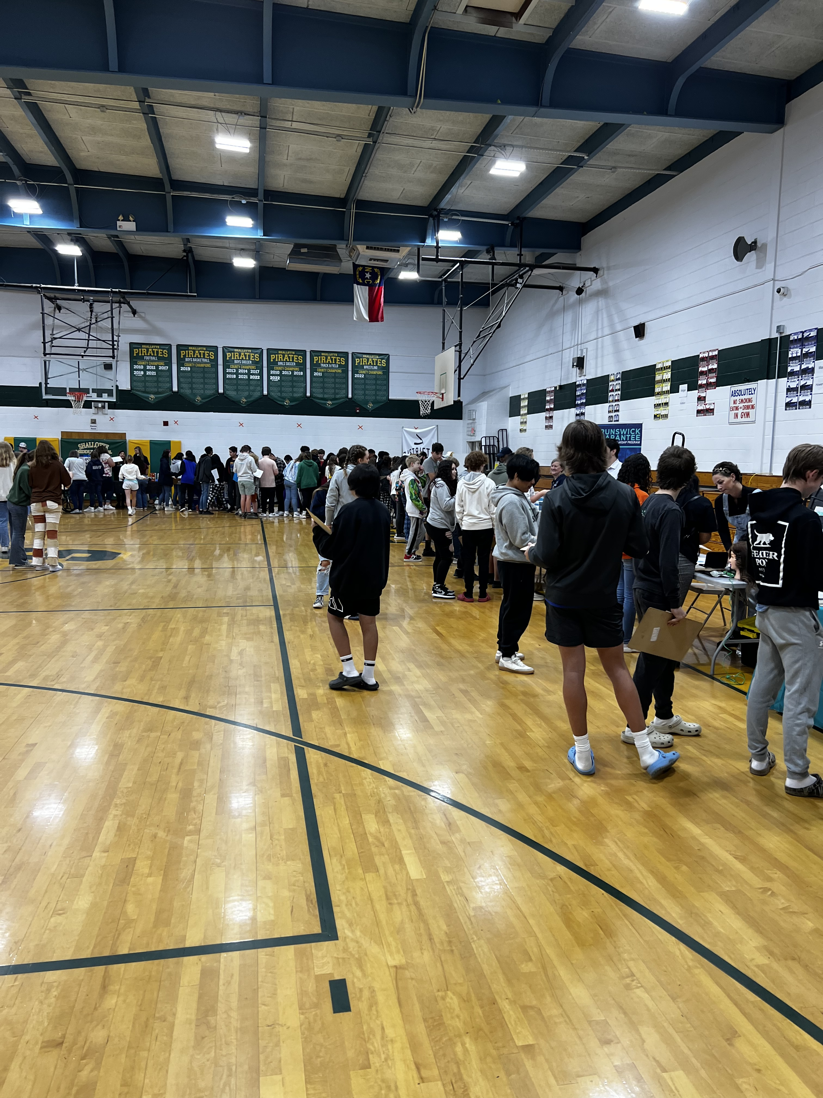
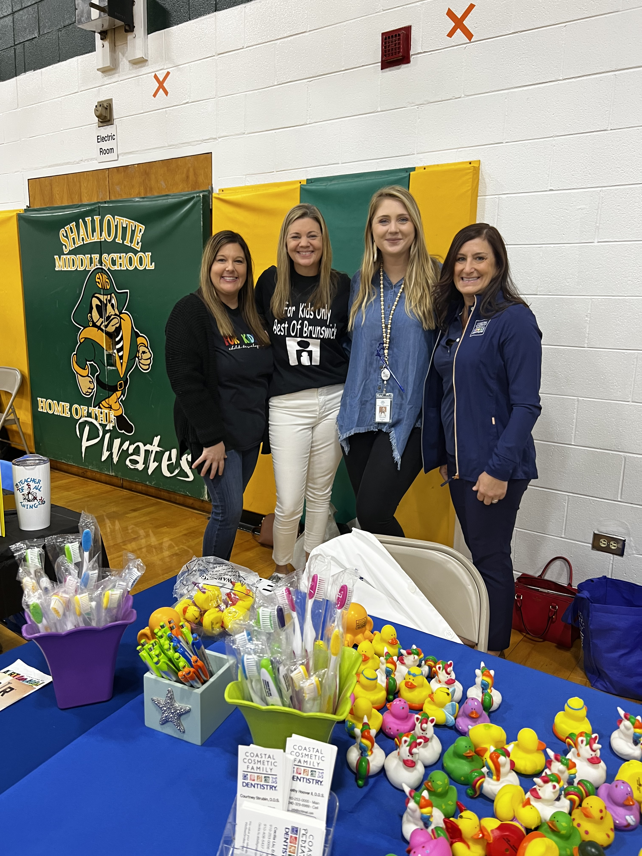
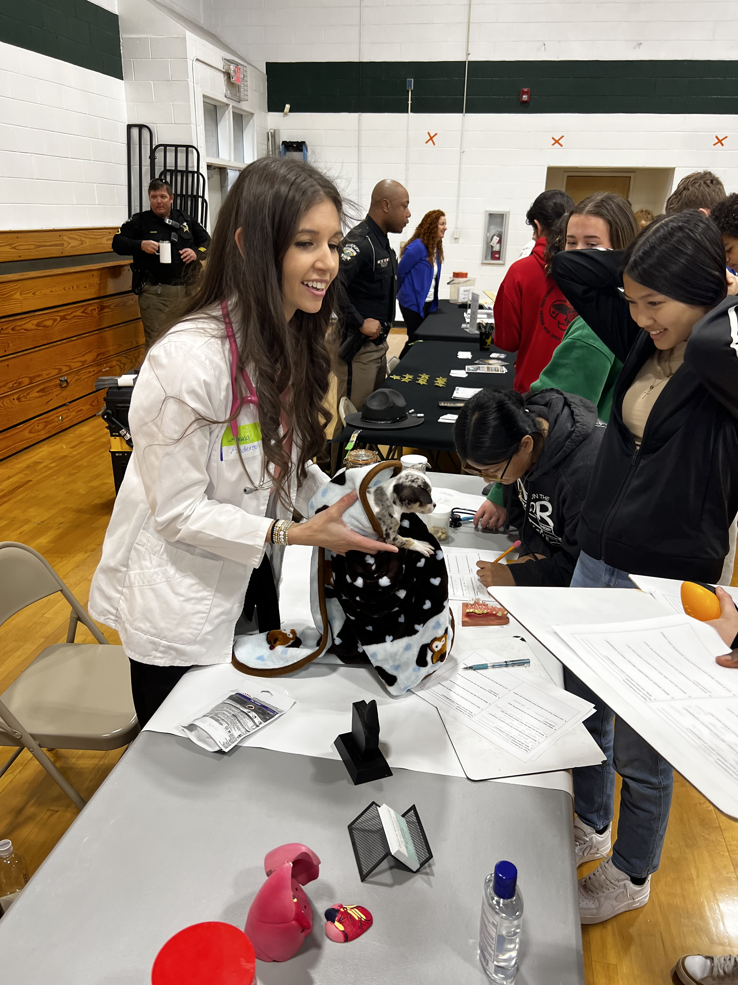
Shallotte Middle Tier I School Wide Support Highlight
Career Day was a big success this year. The CIS Success Coach, Olivia Hintz, planned the entire event herself and ended up getting 26 businesses in our local community to come present to Shallotte Middle School’s 8th grade students. Each student got to walk around to every table and learn about that specific business and what they each did on a daily basis. The students got many souvenirs from the tables, which they loved.

Slide 26
Shallotte Middle Success Story: Nathan

Slide 27
Nathan’s Story:
Nathan was referred to the CIS program after being charged by Deputy Hughes for a simple affray. This was Nathan’s fourth incident of physical aggression this year, others being minor incidents that Deputy Hughes was not notified about. Nathan was fighting in the middle of class with another student, which caused him to receive five days of out of school suspension, and a referral to our Peer Court program. Peer Court is a diversion program through Communities in Schools that if completed correctly can keep charges off of a juvenile’s record. The program includes community service hours, writing apology notes to victims involved, and following a contract. Peer Court also requires a high level of parental support. It is not possible for a student to participate in Peer Court without the parents also being involved with the contract.
Olivia Hintz, the Success Coach, called Nathan’s parents and asked if they would like to participate in the program, and made time for the meeting. His mother was very excited for the program, and supportive of what CIS was doing to help Nathan. She explained to us that some of Nathan’s family has had trouble with the law in the past, and it was important for her to keep Nathan on the right path. Nathan was very involved in the meeting and was understanding of his consequences. CIS also explained the effect that this had on others including his family, teachers, and students in the classroom. Nathan was very polite throughout the meeting, and eager to share his thoughts for his new contract. Nathan ended up agreeing to the hours of community service asked of him and agreed that he would go every weekend until it was finished. It was explained to him that he was not to get in trouble at school or at home during his contract or it would be terminated and sent back to the Department of Juvenile Justice for disposition. Nathan took this very seriously, and even got emotional with his mother in the room.
Nathan successfully completed his CIS Peer Court requirements, but his work didn’t stop there. He thoroughly enjoyed his community service, and coming to school and telling his Success Coach what he did that particular weekend. He told her that he especially liked learning how to bake bread. He often told the other students that he loved Peer Court, and that community service “wasn’t that bad” and he learned a lot from it. Olivia continued to work with Nathan one on one to keep his grades up, and he often came to her office to use his “chill pass” he had from the counselors when a teacher or student made him angry or just to see her and talk about his life. He didn’t get in any more trouble the rest of the school year. He graduated from Shallotte Middle School with A’s and B’s and told his Success Coach he is looking forward to high school and playing football. He knows that he can’t get in trouble and stay on the team and must keep his grades up or he won’t be able to play.
Nathan is Olivia’s success story because of how much effort he put into his contract, and how she was able to see the impact she had on Nathan because of the time she invested in him being successful.

Slide 28
Elementary School Team

Slide 29
Team Members and Schools
Drew Jordan, Lead Success Coach - Supply Elementary
LeAnn Cain, Success Coach - Jesse Mae Monroe Elementary
Corri Proctor, Success Coach - Waccamaw School (K-8)
Morgan Fragale, Success Coach - Lincoln Elementary

Slide 30
Elementary School Demographics
Percentage of Economically Disadvantaged Students by School:
Supply Elementary – 73.6%
Lincoln Elementary – 61.4%
Waccamaw School – 64.5%
Jesse Mae Monroe Elementary – 62.1%
While poverty alone is not an indicator that a student will struggle in school, it is a significant factor and one which can place students at both social and academic disadvantage in comparison to their peers from higher income households.

Slide 31
Snapshot: Waccamaw School
453 Students “C” School Rating Grades K-8
Title I School
TSI CU (Consistently Underperforming Subgroups)
65.0% Math End of Grade Proficiency
53.0% Reading End of Grade Proficiency
24.02% Chronic Absenteeism Rate

Slide 32
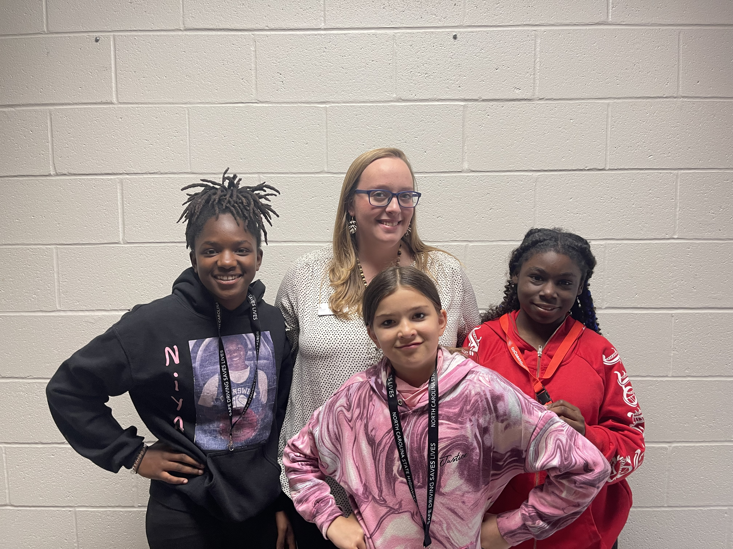
Waccamaw School Tier I School Wide Support Highlight
“Excellent Eagles”
Waccamaw School's goal for the 2022-2023 school year was to improve school climate. One way to improve school climate is student recognition. Excellent Eagles was created to ensure students are being recognized for their good behavior, hard work and successes. Weekly, students are nominated by teachers and school staff for being exemplary. One student from K-2, one from 3rd-5th and one from 6th-8th are chosen and recognized each week on the Monday morning announcements, Waccamaw School Facebook page and Class Dojo. Excellent Eagles serves as motivation for students to strive towards individual goals, be positive, and try their hardest at school. Pictured are some of our 6th grade students who were nominated for Excellent Eagles this year.

Slide 33
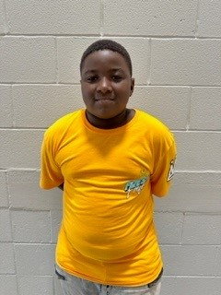
Waccamaw School Success Story: Nizere

Slide 34
Nizere’s Story:
Nizere was referred to CIS for behavior and academic assistance in Math. Nizere worked with Success Coach Corri Proctor throughout the school year on his behavior through interventions such as supportive counseling, incentives, and classroom breaks. Nizere utilized his classroom breaks to talk with his Success Coach about making better choices and to cool down. His Success Coach formed a connection with Nizere through football. He enjoys football and found out that we have the same favorite football team, the Buffalo Bills. Nizere was blown away by this and was even more blown away that Ms. Proctor was from south of Buffalo, New York. He had many questions and enjoyed talking to her about the Bills. Every time he came to his Math group, he wore his Buffalo Bills t-shirt.
Ms. Proctor set his behavior goal with the incentive of pictures and a prize from Buffalo, New York if he were to achieve his behavior goal. When Ms. Proctor went to New York to visit family she took pictures of the Buffalo Bills Stadium and Niagara Falls for Nizere and got him a foam football with the Bills logo on it from the stadium. He was very appreciative and excited when he received this.
Nizere also participated in 4 th grade math groups led by his Success Coach. He enjoyed learning Math through interactive math games such as Math Jeopardy and Math Bingo. Nizere met his goal for Math and behavior this school year. Nizere also received books from International Paper for summer reading.

Slide 35
Snapshot: Jessie Mae Monroe Elementary
391 Students “C” School Rating Title I School
55.9% Math End of Grade Proficiency
48.5% Reading End of Grade Proficiency
13.47% Chronic Absenteeism Rate
24.6% Incoming Rate of Readiness for Kindergarten

Slide 36
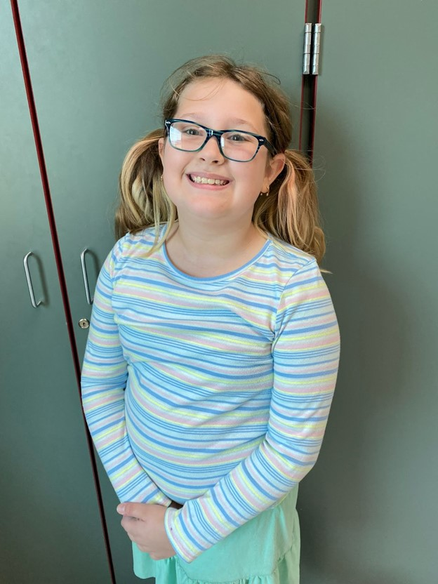
Jessie Mae Monroe Success Story: Kura

Slide 37
Kura’s Story:
Kura was a 4th grade student at Jessie Mae Monroe Elementary School. She lived at home with her parents, brother, and sister. She loves to draw and play. The CIS Success Coach conducted daily check ins with Kura after being referred for lack of motivation in the classroom. Kura participated in social emotional learning and character development with her CIS Success Coach every afternoon.
Kura enjoyed having time to settle and reflect during her time with her Success Coach. They would often play games and or draw to have time to decompress and discuss the successes and challenges of the day. Kura would often use the time to open up in a safe place to discuss obstacles and struggles from school and home.
Kura showed positive improvement during the school year. Teachers expressed that she seemed happier and more engaged in the classroom. Kura expressed that she enjoyed being in the CIS classroom because her Success Coach was very helpful and supportive as well as fun to be around.
Kura improved in the classroom because she felt connected and supported at Jessie Mae with the help of her CIS Success Coach.

Slide 38
Snapshot: Lincoln Elementary
654 Students “D” School Rating Title I School
Targeted Support and Improvement (TSI), TSI CU (Consistently Underperforming Subgroups), and NC Designated Low Performing School
54.4% Math End of Grade Proficiency
41.4% Reading End of Grade Proficiency
28.49% Chronic Absenteeism Rate
31.2% Incoming Rate of Readiness for Kindergarten

Slide 39
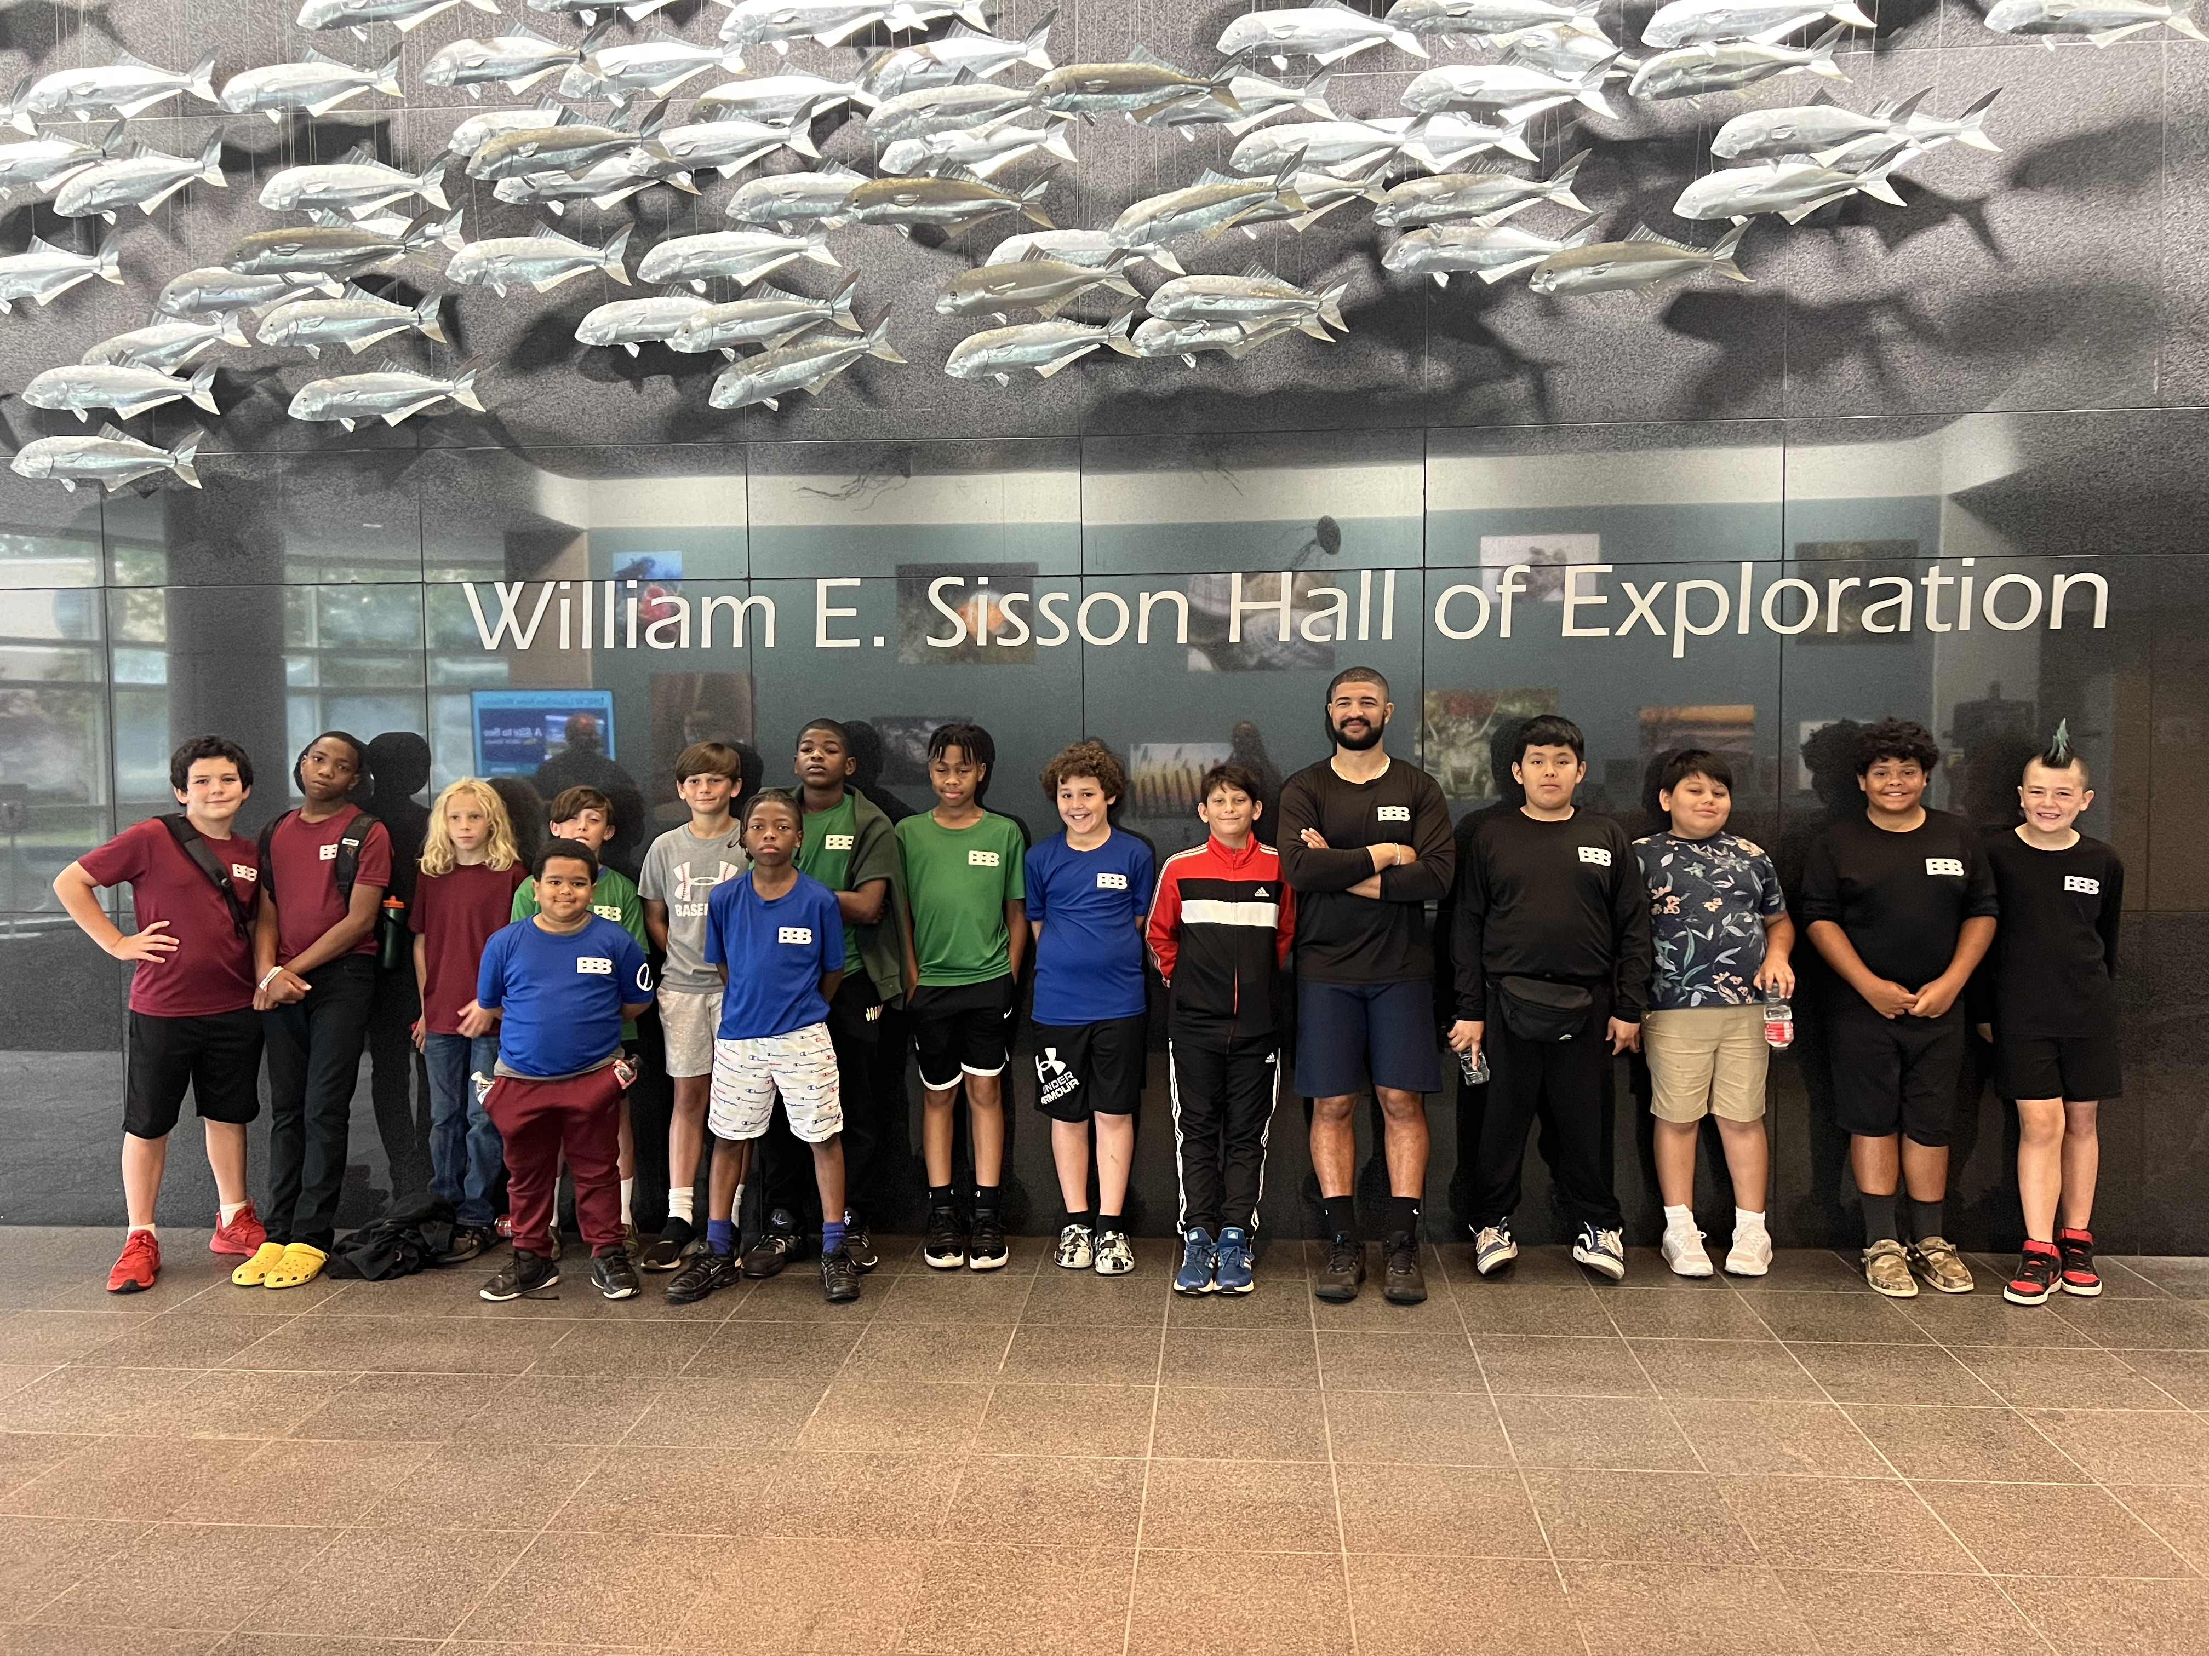
Lincoln Elementary Tier I School Wide Support Highlight
Continuing the partnership again this year between the Brick-By-Brick group and the UNCW EVS Department, the Brick by Brick group took its annual field trip to UNCW in June. Having the support of faculty members to continue to grow the group and provide students opportunities they wouldn't normally have has been a privilege to coordinate. Overall, Brick by Brick grew by twenty students from year one to year two, and this has given us the chance to grow our mission and continue to support young men moving through the education system!

Slide 40
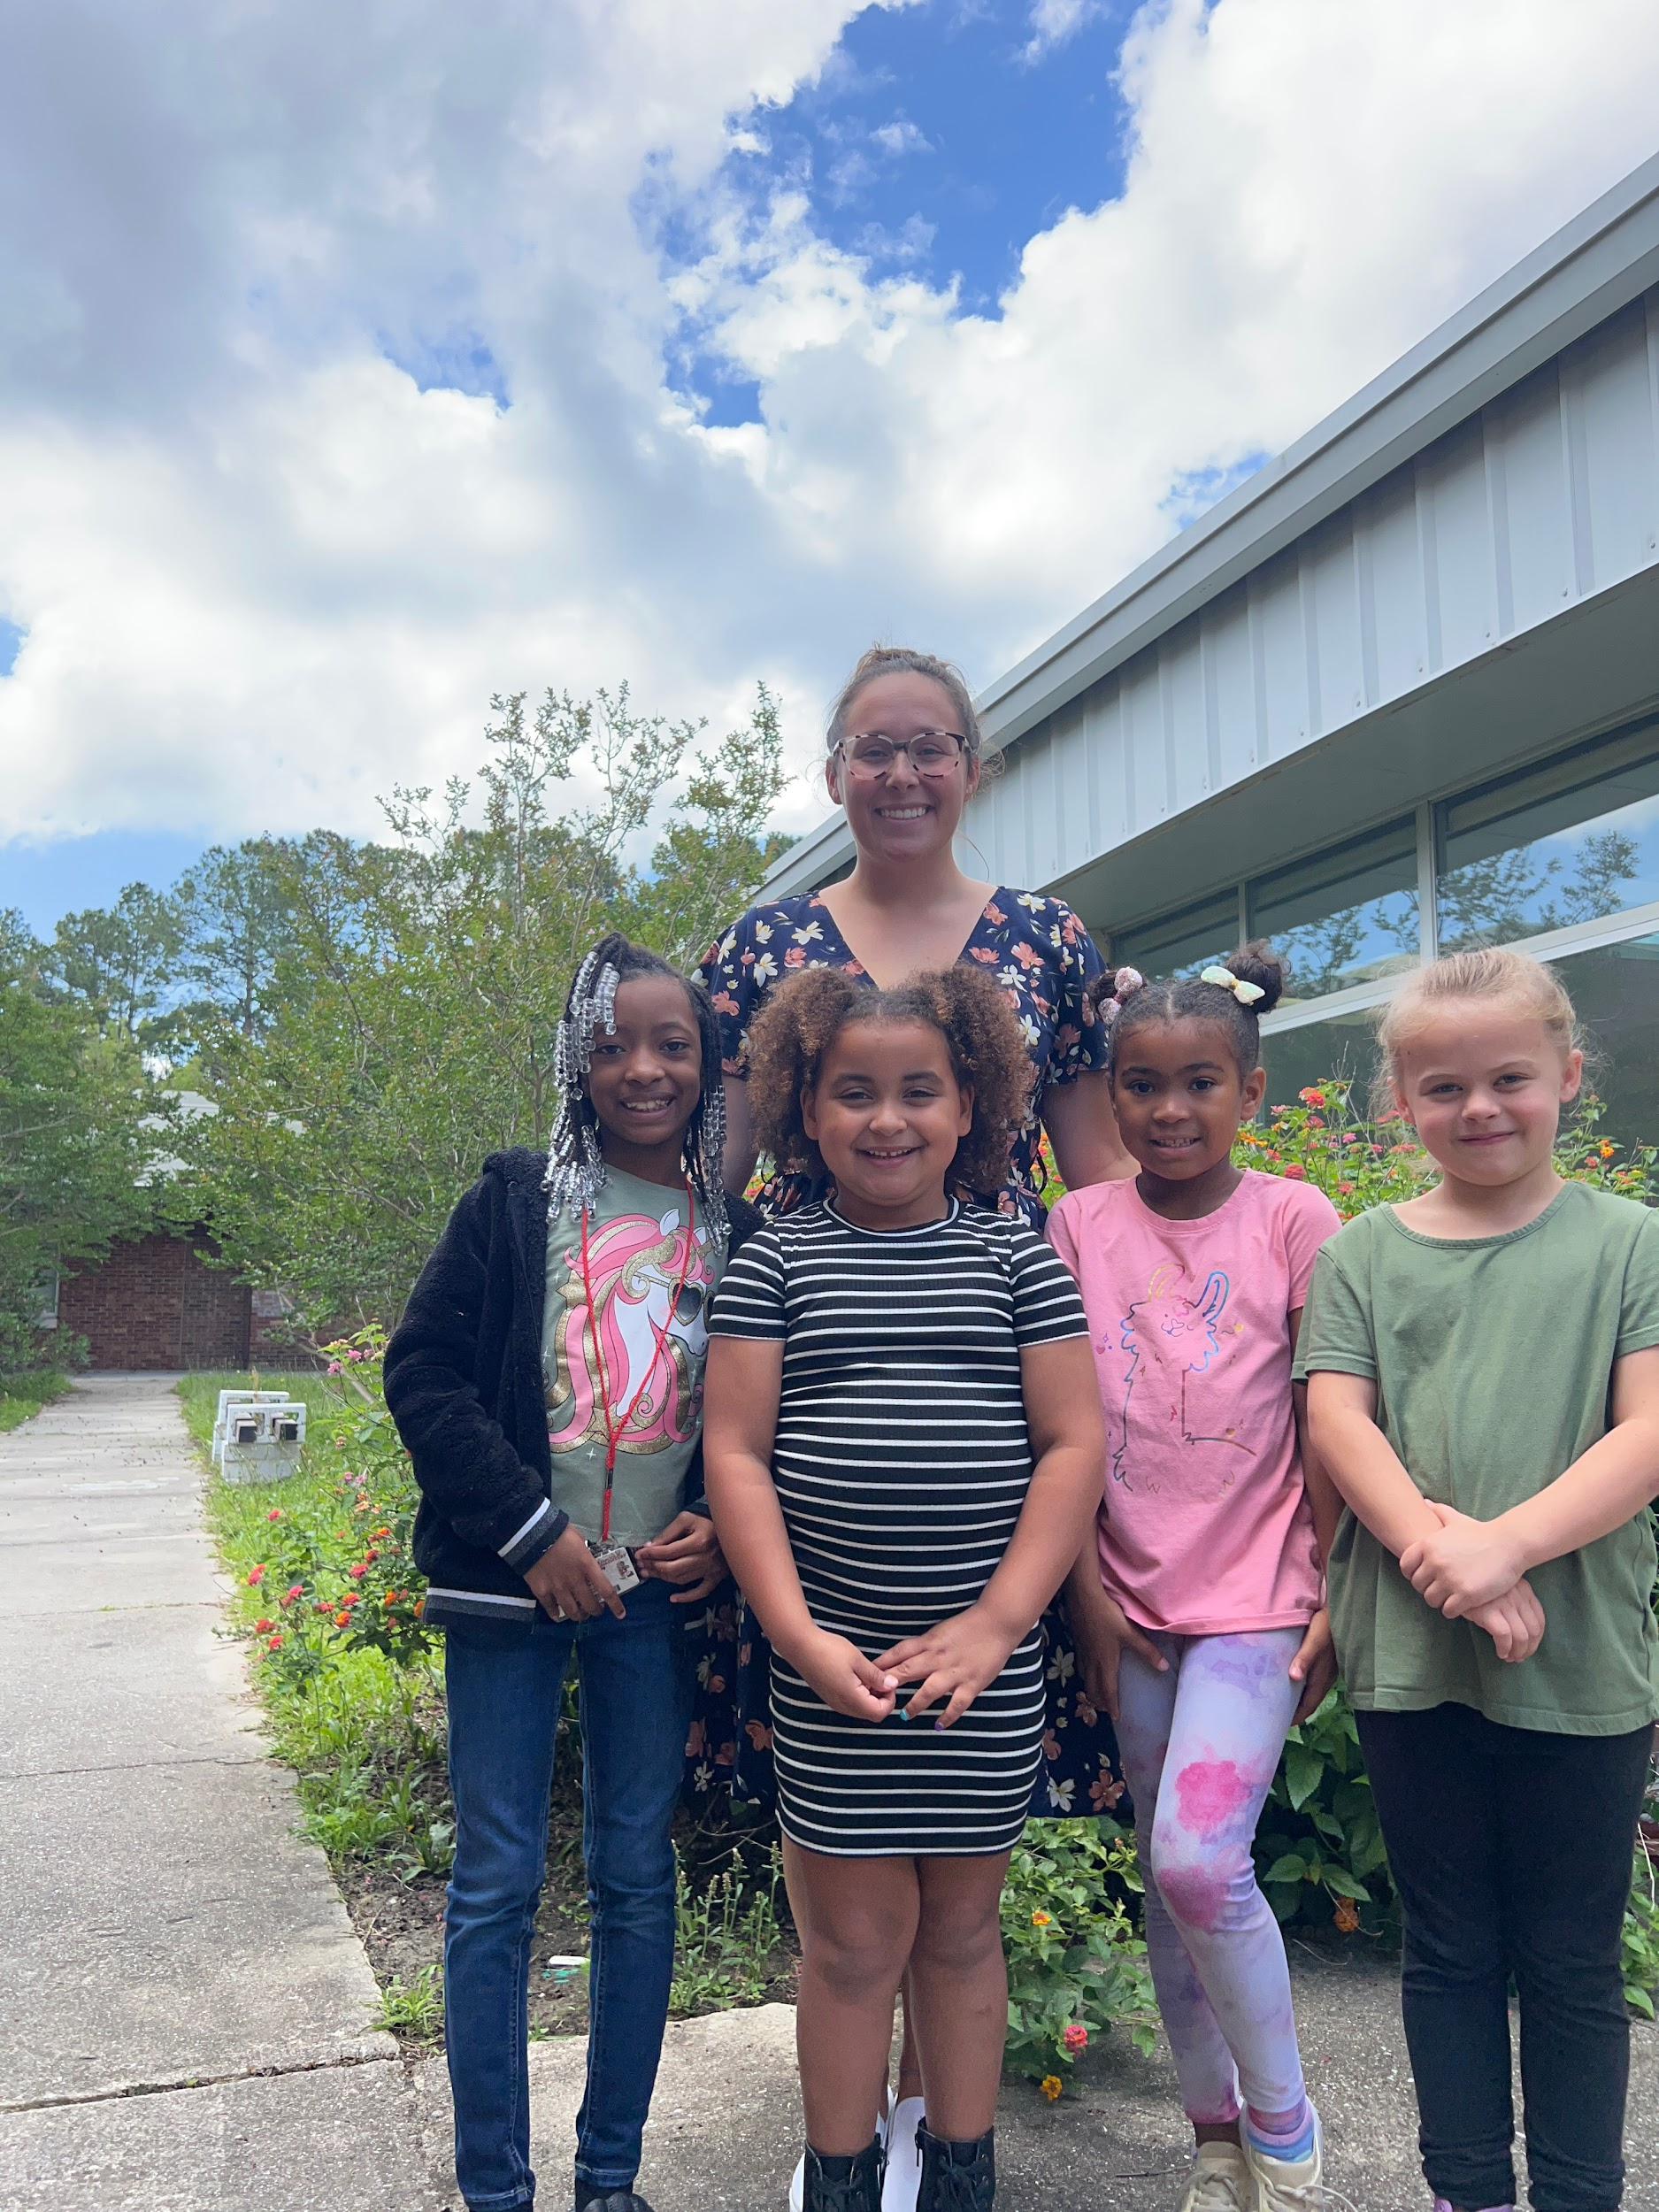
Lincoln Elementary Success Story: MacKenzie, Malayah, Audrey, and Ashlynn

Slide 41
The Girls’ Success Story:
The first- grade girls’ group at Lincoln Elementary are resilient, kind and always looking for ways to include others. With these girls leading the way! Success Coach, Morgan Fragale, held a “bring your friend to lunch day” where the girls could pick another student to bring along who could use a friend, to cultivate kindness within the school. The four girls, Mckenzie, Malayah, Audrey and Ashlynn, continued to surprise Morgan as they decided to pick up trash on the playground, color encouraging pictures for 5th graders during testing, and brainstorm ideas for next school year. The Lincoln Leaders are Leading the Way for this coming school year!
Audrey, a new student at Lincoln for first grade, refused to come to school the first two weeks of school. She came in crying each day her parents brought her in. Audrey would sit alone at recess and not speak in class or at lunch. Her teacher sent her to the CIS office one day after crying for most of the morning. When Morgan first met Audrey, she didn’t talk to her at all. They sat on her office floor together while Morgan read a book out loud. This continued for a week. Finally, Audrey asked if Morgan could read “Wonder”. Morgan took this moment and ran with it. She got her to talk about the books she liked and why. They talked about reading and her favorite stories for 45 minutes. The next day, they started “Wonder”. She stopped refusing to come to school, started doing school work, and even began playing at recess. In a meeting with her parents, Morgan learned that the move to where they were now living was very hard as they moved away from a strong family unit - one in which included family members reading to her.
Morgan continued to check-in every morning and afternoon with Audrey. Above grade level in Reading, Audrey struggles in Math. It is her idea of “I suck at math. Why can’t it be like reading?” that started the Success Coach’s effort to change Math problems into work problems for kids who struggle with Math but find reading easier. The start of the girls group (pictured) provided Audrey friends in different classes, at lunch and on the playground. These girls even started a book club with Morgan in which they all sit on the floor and read together. For second grade, they started the Book Club again & Audrey even asked to bring a new friend.

Slide 42
Snapshot: Supply Elementary
501 Students “C” School Rating Title I School
Targeted Support and Improvement (TSI), TSI CU (Consistently Underperforming Subgroups), and NC Designated Low Performing School
64.1% Math End of Grade Proficiency
45.4% Reading End of Grade Proficiency
41.25 Chronic Absenteeism Rate
< 5% Incoming Rate of Readiness for Kindergarten

Slide 43
Supply Elementary Tier I School Wide Support Highlight
Chess Club was held during the school day every Friday for 4th and 5th grade for PBIS (Positive Behavior Interventions and Supports) club days. Through Chess Club, students were taught to master a basic understanding of how chess is played, demonstrate respect, patience, critical thinking, and good sportsmanship. Through the rules and structure of chess, students learned how to process situations/information and apply similar analysis and decision- making skills with their behavior at school.

Slide 44
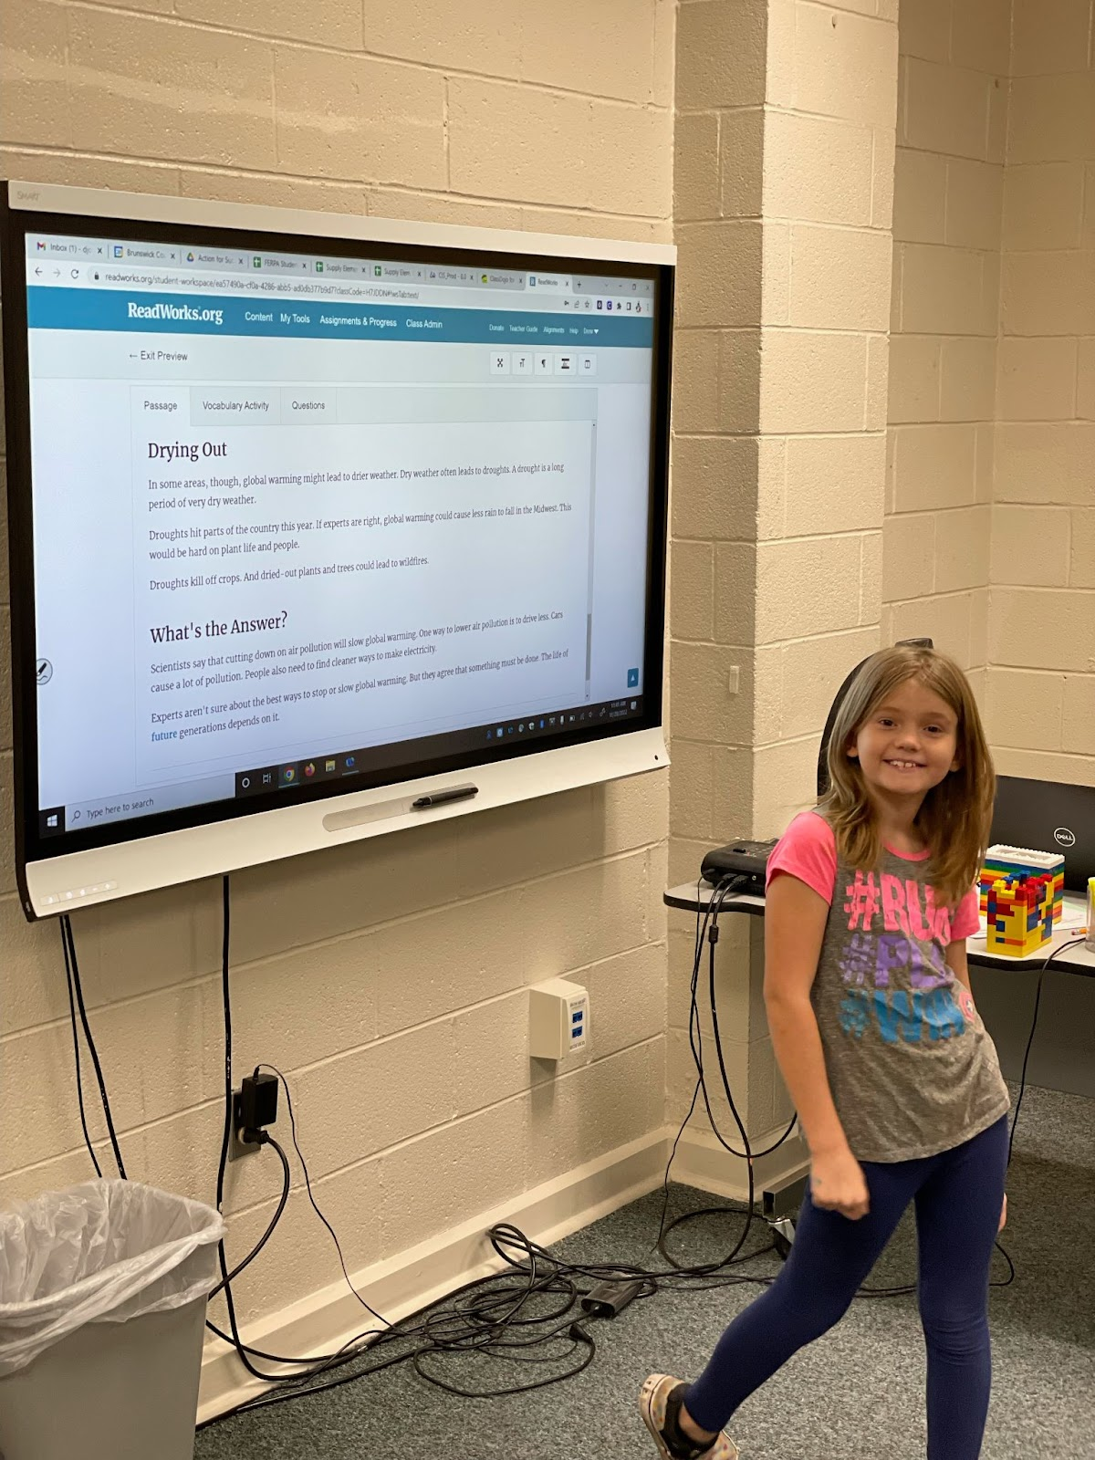
Supply Elementary Success Story: Aubrey

Slide 45
Aubrey’s Success Story:
Imagine it’s the 2021-2022 school year, COVID is still affecting how you go to school, you come to school in a mask and have to stay in your classroom from the time you arrive at 8:30 am until the end of the day at 3:30 pm, you have breakfast and lunch all in the same room. Your motivation to come to school is low and you don’t feel connected to your classwork. You have a 64.88% attendance rate and a 61 in Language Arts, and you get told you’ve been referred to a program called Action for Success. You return to school, and you meet your Success Coach. How can this goofy guy Mr. Drew help you with your attendance and schoolwork?
You begin working with Mr. Drew and check in with him each morning for your attendance check-ins, coloring in your attendance tracker for the days you’re here and earning your reward of eating lunch in his office every Friday if you’re here all week. You begin coming to Mr. Drew’s office once a week to work on your makeup work and practice your Reading skills.
Fast forward to third grade, it’s the 2022/2023 school year, and you continue your work with Mr. Drew, checking in each morning, now with a smile on your face. You now begin to ask your teacher to go to Mr. Drew’s office more than your normal time to check in more often and ask to earn lunch more often than once per week if you get your classwork for the day done. You ask to come work with your Success Coach each morning to practice your Reading and talk about your weekend, tv shows, and movies you watched over school breaks.
It’s now the end of your third- grade year, you’ve brought your Reading grade up from a 61 to a 71, your attendance has improved from 64.88% to 84.44%, and you refuse to go to class on the last day of school because you want to come to your favorite class for the entire last day since you won’t be able to go to CIS over the summer. You head to the bus to start your summer break and you turn to tell your Success Coach that “You better be here next year, because I will be so mad if I get here and you’re at another school! Okay byeeee!”
You’ve now put yourself in the shoes of Aubrey, a CIS student at Supply Elementary for the past 2 school years.

Slide 46
Principal Quotes
South Brunswick Middle: Joshua Parker, Assistant Principal:
"CIS is a program that brings support and guidance from the community back into our schools for students who are struggling to find themselves in an ever changing world. CIS bridges the gap for students to receive more support and provide an advocate for the students and families to help ensure the success of the student.“
Leland Middle: Shawn Black, Principal:
"Communities In Schools led by Mrs. Ruth Thompson has and will continue to have positive affects on our school culture, student success in academics and student behavior. Mrs. Thompson along with our success coaches provide a much needed mentorship for some of our most needy students.“
Waccamaw School: Roman “Michael” Kelley, Principal:
"We are grateful for another year of partnering with the CIS program. Our students have shown growth not only academically but behaviorally as the school year progressed. We look forward to continuing this partnership in the future.“
Shallotte Middle: Chris Orrock, Assistant Principal:
"Mrs. Hintz has come in and established great relationships with our students this year. She is personable and works well with our staff. Mrs. Hintz is an asset for our staff and students and we are excited for the next school year."

Slide 47
21st Century Community Learning Center
Afterschool Program

Slide 48
Afterschool Program
Alison Kaplan, Program Director
Provided at Supply Elementary
5 days per week
Grades 2 – 5
FREE of cost for participants / grant funded program
Program Elements:
Daily Snack Daily Bus Transportation Home
Homework Assistance Reading Pals
Tutoring Parent Engagement Activities
STEM Hands On Learning Recreational Activities
Social Emotional Learning Physical Health and Healthy Eating Curricula

Slide 49
Afterschool Program: Supply Elementary
Students Participating: 77
Attendance:
Students who attended 45+ hours: 71
Students who attended 90+ hours: 60
Students Showing Measurable Academic Progress:
English / Language Arts- 44%
Math- 52%
Attendance had a significant impact on academic progress. Some students did not attend regularly due to doctor’s appointments, sports, parents not wanting them to get home too late in the evening or being removed from the program due to serious and ongoing behavioral issues.
The 21st Century Community Learning Center at Supply Elementary was funded through a three-year federal grant
School year 2022-2023 was the final year of the grant cycle and the program at Supply Elementary until another grant opportunity becomes available

Slide 50
Plans and Goals FY 2023-2024
Restorative Practices as a disciplinary and juvenile court diversion intervention will formally replace the Peer Court Program. All staff will implement the Restore Program at their schools. Our two Program Directors will be trained as Restorative Practices trainers through CISNC so they can provide ongoing training and support to the Success Coach team.
CIS of Brunswick County will start recruiting members for a new Young Professionals Board in Fall 2023 to provide opportunities for those who live or work in Brunswick County between ages 25 and 35 to learn more about non- profit board functions, host fundraising events for CIS, increase awareness of CIS in the community, and support our programs through volunteerism and in-kind support. This group will also serve as pipeline for future Board of Directors membership.
CIS will open a new thrift shop in Shallotte in late 2023 to provide an additional source for generating unrestricted revenue for CIS to support its programs and overall operation.
An expanded focus on fundraising events, donor development and stewardship, and grant writing will help sustain existing programs and position CIS for future growth.
A new thrift shop inventory process will be implemented to bring CIS into compliance with current GAAP standards and annual audit requirements, accounting for thrift shop donations and revenue generation.
A focus on increasing lines of communication and team building opportunities between all levels of staff will aid in fostering a more supportive team environment.
Professional Learning Communities will continue to be used to increase staff connectedness and provide professional growth for staff.
Strengthening board involvement in stewarding donors, supporting fundraising efforts, and identifying and developing future board leaders will help ensure a strong and sustainable organization.

